Slide 1

Example of a simple data organization system
A practical guide to data management and sharing for biomedical laboratory researchers
Fouad K*, Vavrek R, Surles-Zeigler MC, Huie JR, Radabaugh H, Gurkoff GG, Visser U, Grethe JS, Martone ME, Ferguson AR, Gensel JC*, Torres-Espin A*

Slide 2
Levels of data
Lab
Experiments
Subject
Observation
Study
The whole data collection history of the lab
A study may be compressed of several experiments
We have several subjects per experiment
Each subject is unique
We make several observations or measures in different variables per subject

Slide 3
Study design and planning of research activities
Collect
Process
Analyze
Archive
Share
Plan
Re-use
Generate new knowledge and insights from already collected data
Run the study and collect data, material, samples, etc.
The Research Data Lifecycle
Provide access to others in a usable format
Generate data from collected samples and material. Process raw data into meaningful read-outs
Analyze data to generate primary insights and knowledge
Long-term data preservation

Slide 4



A simple data storage and management file structure
Lab data storage
Lab documentation
All documents needed for the lab to function (e.g., SOPs, training material, product catalogs)
Data
The main folder is where all the data is stored
Experiment catalog
A file to track each experiment and provide basic information
AA1
Each experiment has its folder named with a unique identifier (e.g., AA1)
AA1 summary log
A document that logs the activities that happen for each experiment
AA1 subject catalog
A document listing and cataloging each subject
AA1 data dictionary
Contains the definitions for all variables and measurements, their units, permitted values, and other information at the variable level
Analysis and results
A folder containing all the analysis documents (e.g., R scripts, SPSS files) and results and outputs of analysis (e.g., graphs, slide presentations)
Processed data
Raw data
Files containing the processed data. We recommend having files in a sharable format (e.g., csv) and having data dictionaries
AA2
…
This can be the place to store digital raw data such as microscope images, videos, electrophysiology recordings, etc.

Slide 5
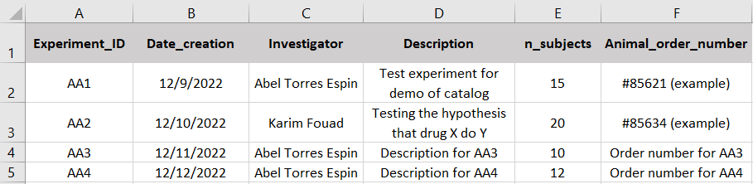
A simple data storage and management file structure
Lab data storage
Lab documentation
Keep a list of experiments performed
Data
Experiment catalog
AA1
AA1 summary log
AA1 subject catalog
AA1 data dictionary
Analysis and results
Processed data
Raw data
AA2
…

Slide 6
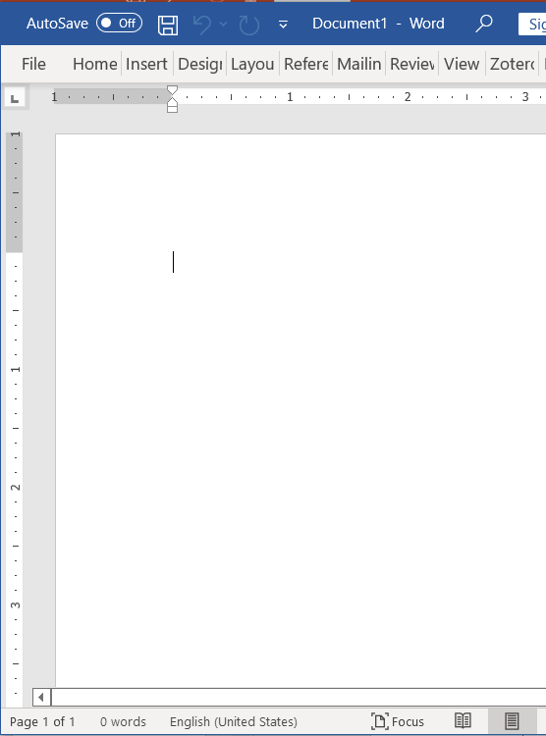
A simple data storage and management file structure
Lab data storage
Lab documentation
Data
Experiment catalog
Project Summary
AA1
Title:
AA1 summary log
Lead researcher:
AA1 subject catalog
Description and Aims:
Project log:
AA1 data dictionary
12/10/2022:
Bla bla bla
Bla bla bla
Analysis and results
Processed data
Raw data
12/09/2022:
AA2
…
Updated once a week from lab notebook or as electronic notebook

Slide 7
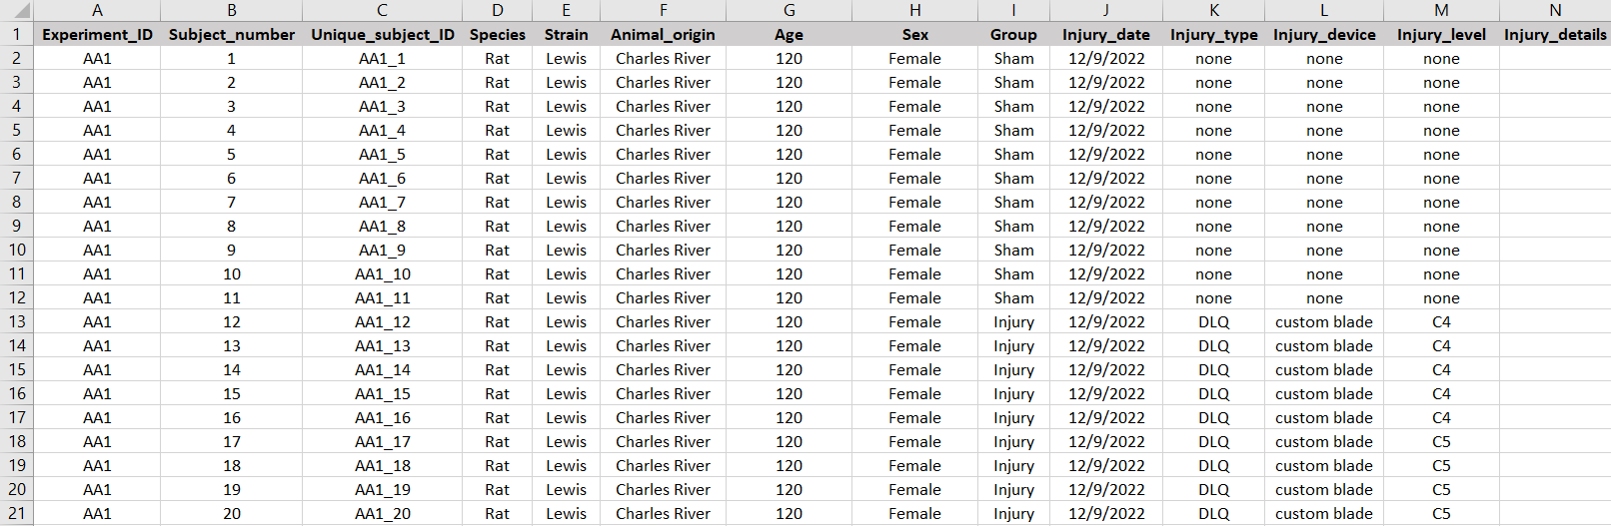
A simple data storage and management file structure
Lab data storage
Lab documentation
Data
Experiment catalog
AA1
AA1 summary log
AA1 subject catalog
AA1 data dictionary
Analysis and results
Processed data
Raw data
AA2
…

Slide 8
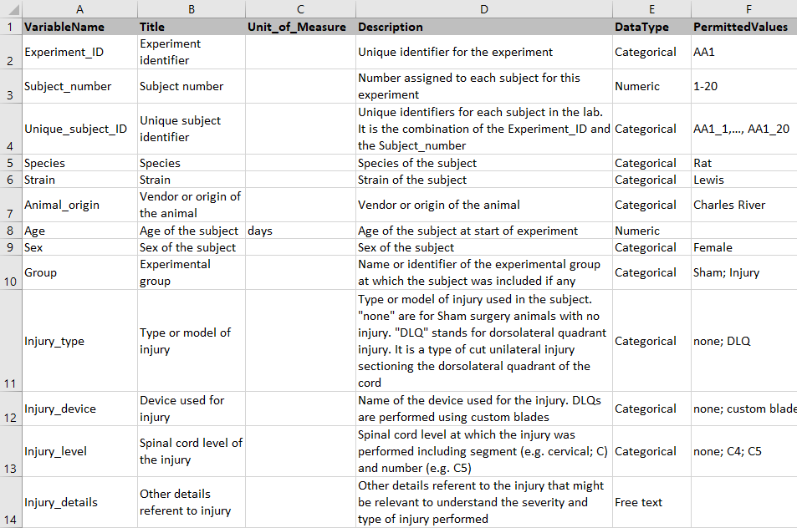
A simple data storage and management file structure
Lab data storage
Lab documentation
Data
Experiment catalog
AA1
AA1 summary log
AA1 subject catalog
AA1 data dictionary
Analysis and results
Processed data
Raw data
AA2
…

Slide 9
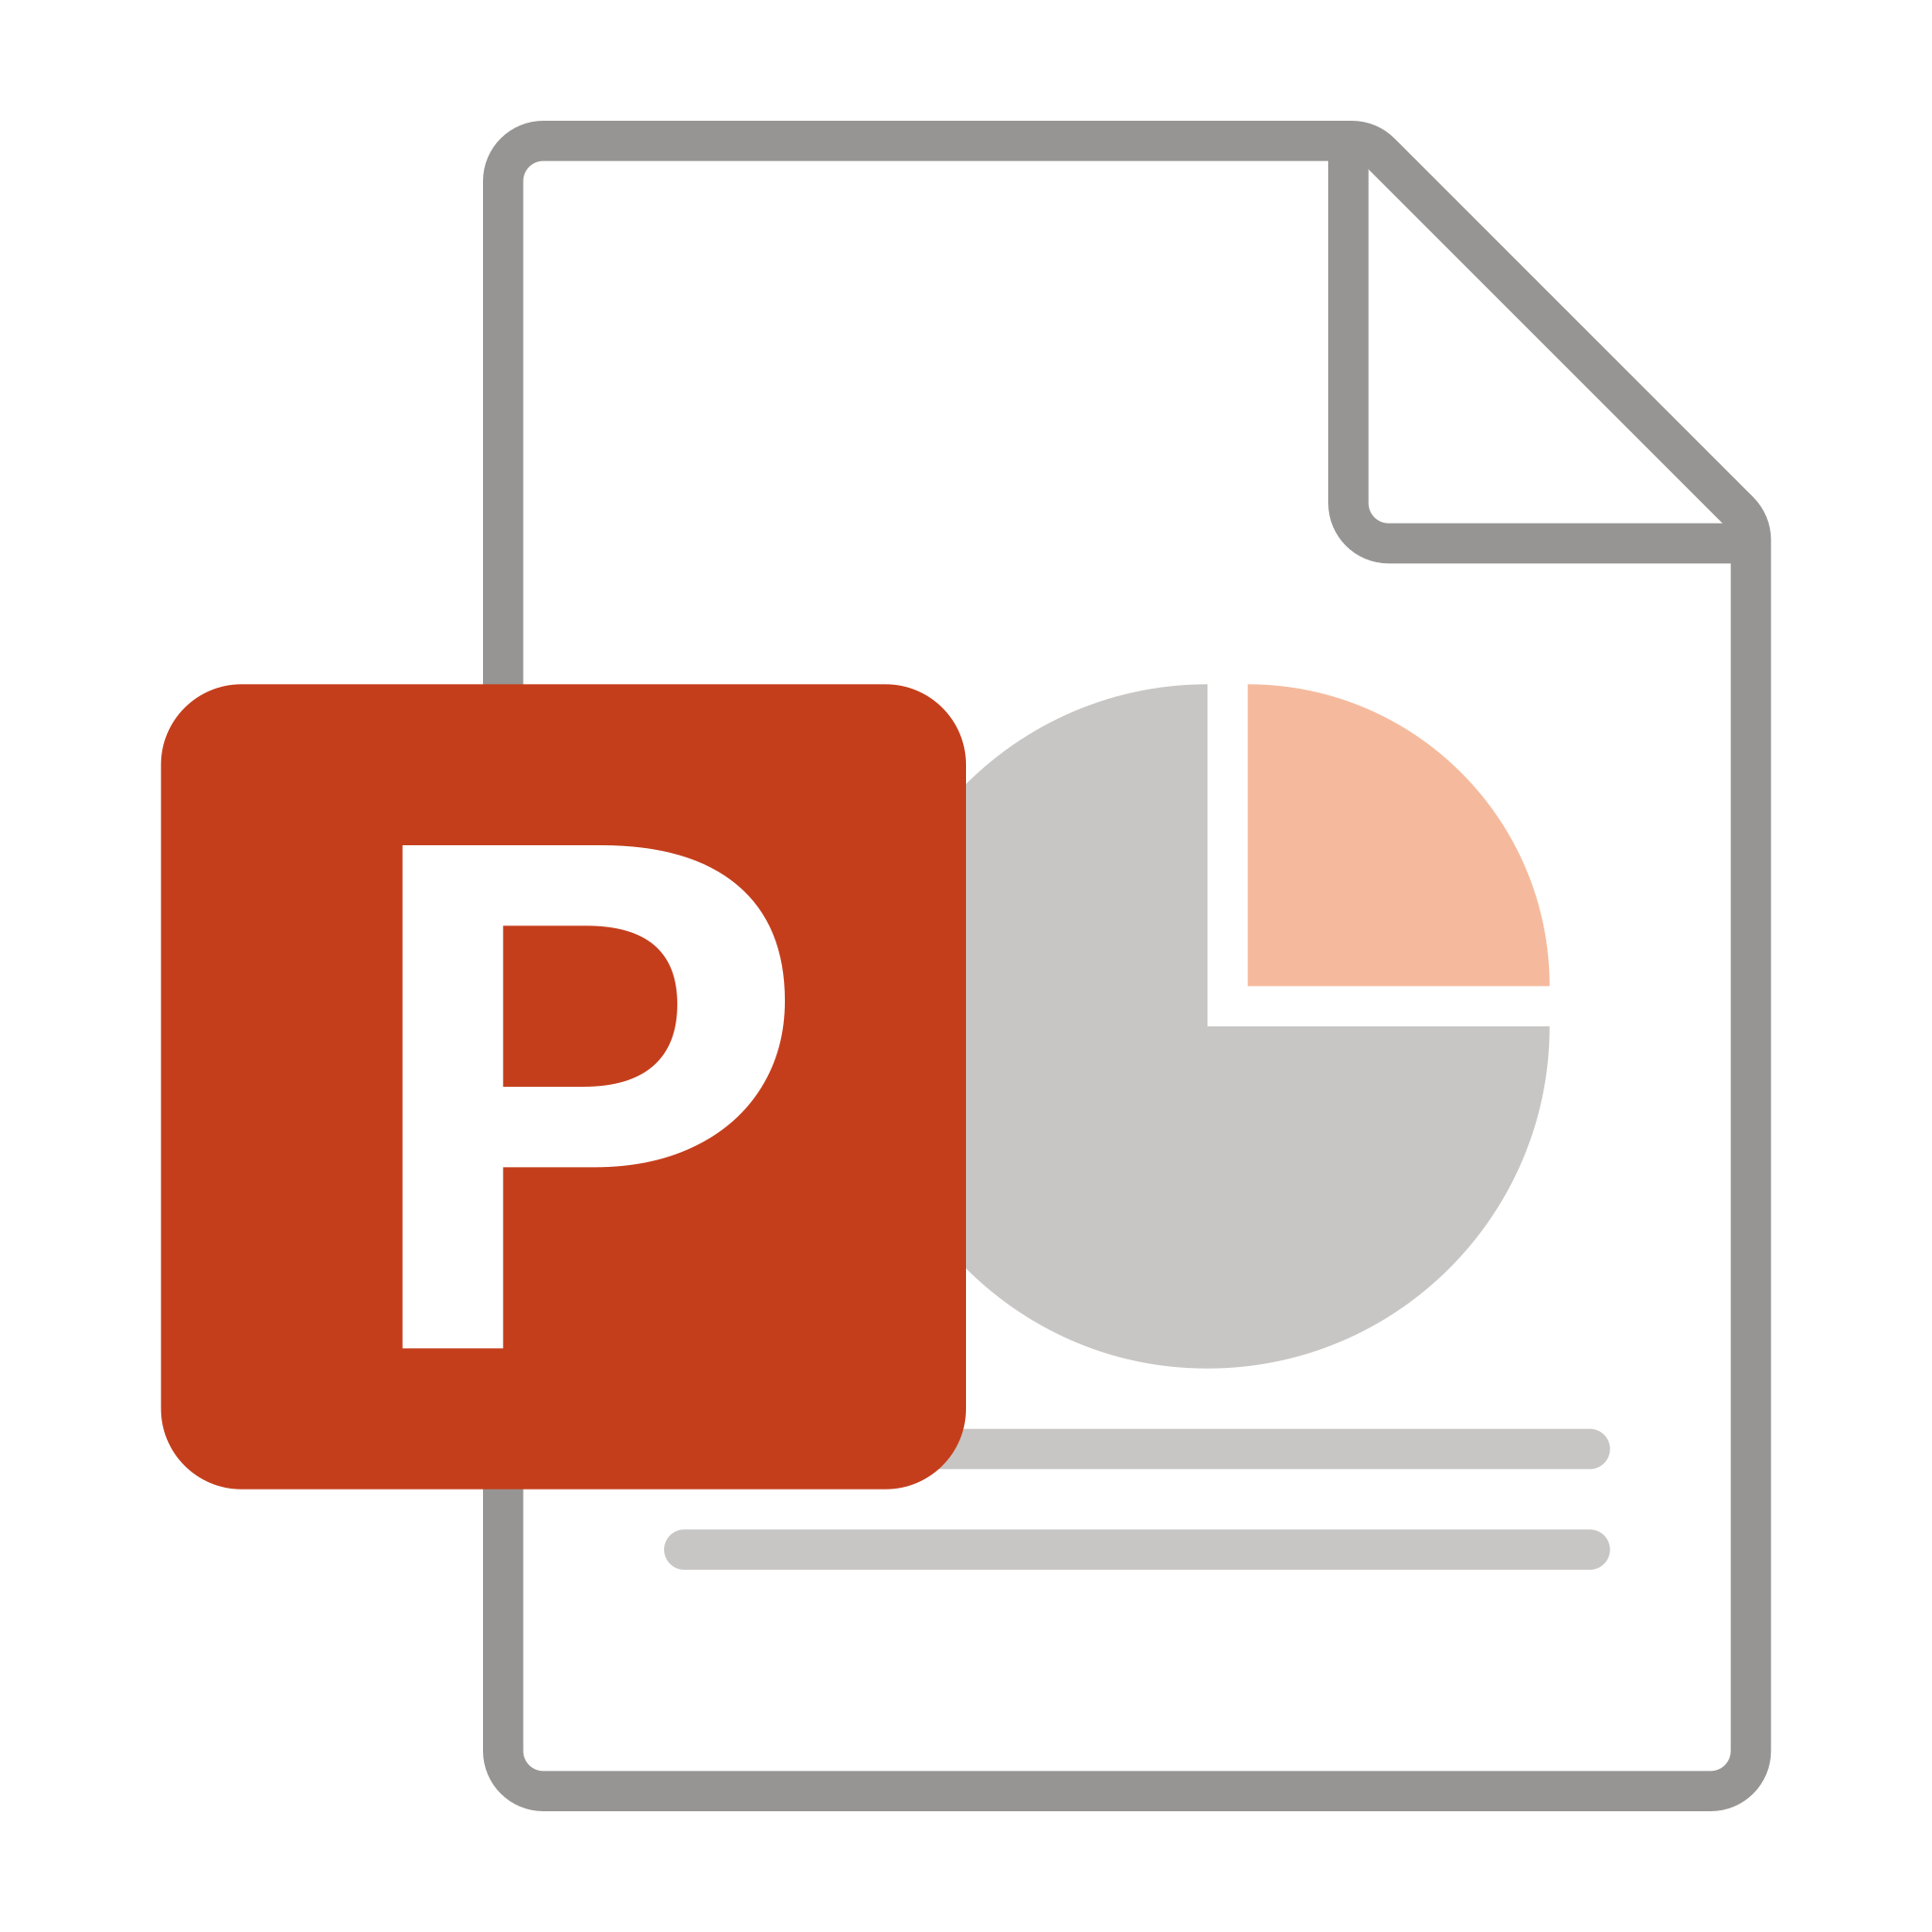

A simple data storage and management file structure
Lab data storage
Lab documentation
Data
Experiment catalog
AA1
AA1 summary log
AA1 subject catalog
AA1 data dictionary
AA1 Results presentation 12102022
Analysis and results
AA1 prism analysis 12102022
Processed data
R scripts
Raw data
AA2
…

Slide 10
A simple data storage and management file structure
…
…
Lab data storage
Link_to_data
Link to raw data
Lab documentation
Link to raw data
Data
Experiment catalog
AA1
AA1 summary log
AA1 subject catalog
AA1 data dictionary
AA1 IBB
Analysis and results
Processed data
AA1 SPG
Raw data
AA1 Histology
AA2
…
…

Slide 11


A simple data storage and management file structure
Lab data storage
Lab documentation
Data
Experiment catalog
AA1
AA1 summary log
AA1 subject catalog
AA1 data dictionary
Analysis and results
Processed data
AA1_1 SPG 2dpo video
Raw data
AA1_1 SPG 2dpo C5 NeuN
AA2
…
…

Slide 12
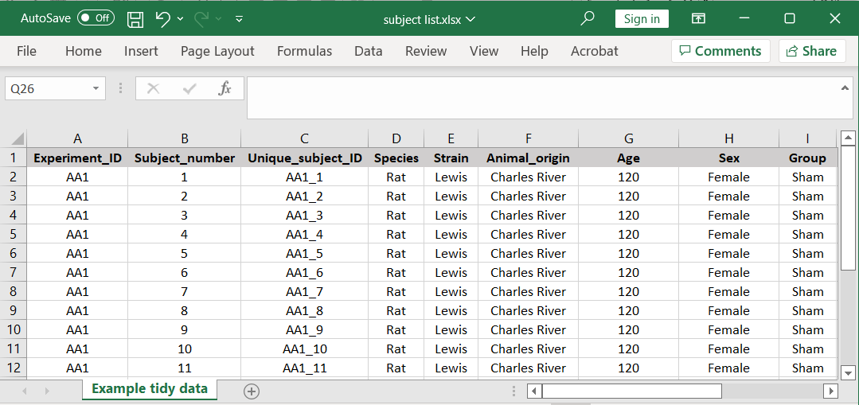
The tidy data: how to organize data on a spreadsheet
Save as .csv file
First row are variable names (headers)
Each column is a variable
All other rows are data
There is a single sheet
Know more at:
Broman & Woo (2018) Data Organization in Spreadsheets, The American Statistician, 72:1, 2-10,
DOI: 10.1080/00031305.2017.1375989

